Slide 1

A national obsession!
Weather Watching
This Photo by Unknown author is licensed under CC BY.

Slide 2
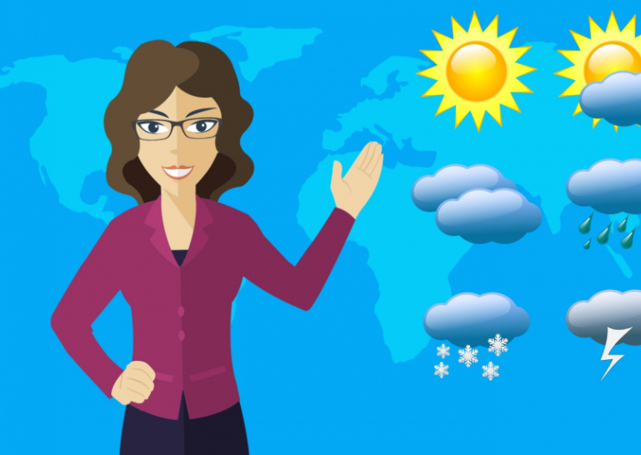
Weather Watching
Here in the UK we seem to have an obsession with the weather. As soon as conversation runs dry, we revert to talking about the weather, or, sometimes, we START a conversation by talking about the weather. The weather, then, is always of interest to us … It affetcs what we do, what we wear, and how we feel.
In days gone by, you looked out the window, and you could decide what you were going to tjhat day, or what you were going to wear, but what if we could have a much more detailed record of the weather … the weather today, and the weather over the past year ?

Slide 3
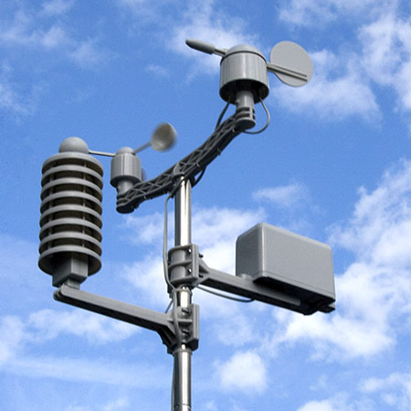
Bringing technology to the weather party !
The good news is that now, every home can do exactly that … by investing in a weather station !
Weather stations are now remarkably cheap, and many schools and nurseries have one so that the children can undertake a project about the weather. At Borders College, we also have a weather station, however it hasn't been installed yet, so, until it HAS been set up, we'll look at the data produced by my own weather station.
This Photo by Unknown author is licensed under CC BY-SA.

Slide 4
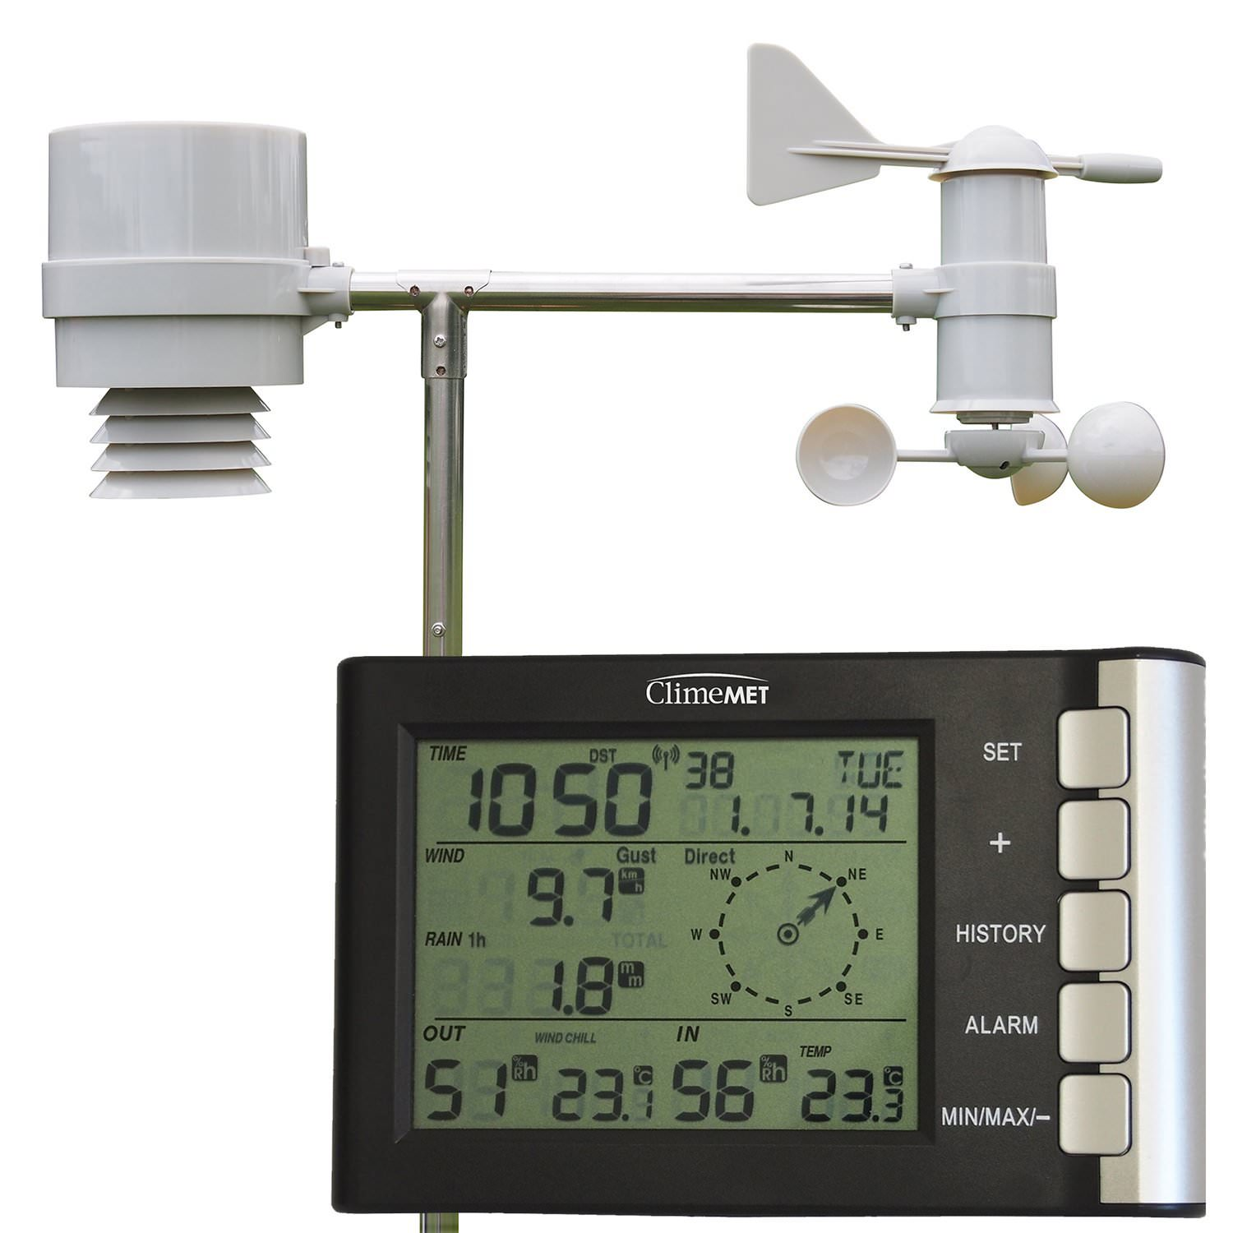
The parts of a weather station
Weather stations generally consist of 2 parts … the actual sensors, which are located outside, and a base station in the house which tells you what the sensors are detecting.
This Photo by Unknown author is licensed under CC BY-SA-NC.

Slide 5
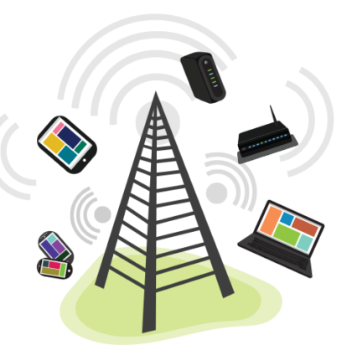
Uploading of data to the internet
The sensor connects remotely to the base station, and the base stations are often connected to the wi-fi network in your house, sending data to a website so that you can view the data online.
This aspect of the station may seem a little pointless, but it means that the data over time is saved, and can be referred to in the future, and it is THIS aspect of modern weather stations that make them such a useful tool !
This Photo by Unknown author is licensed under CC BY-SA-NC.

Slide 6
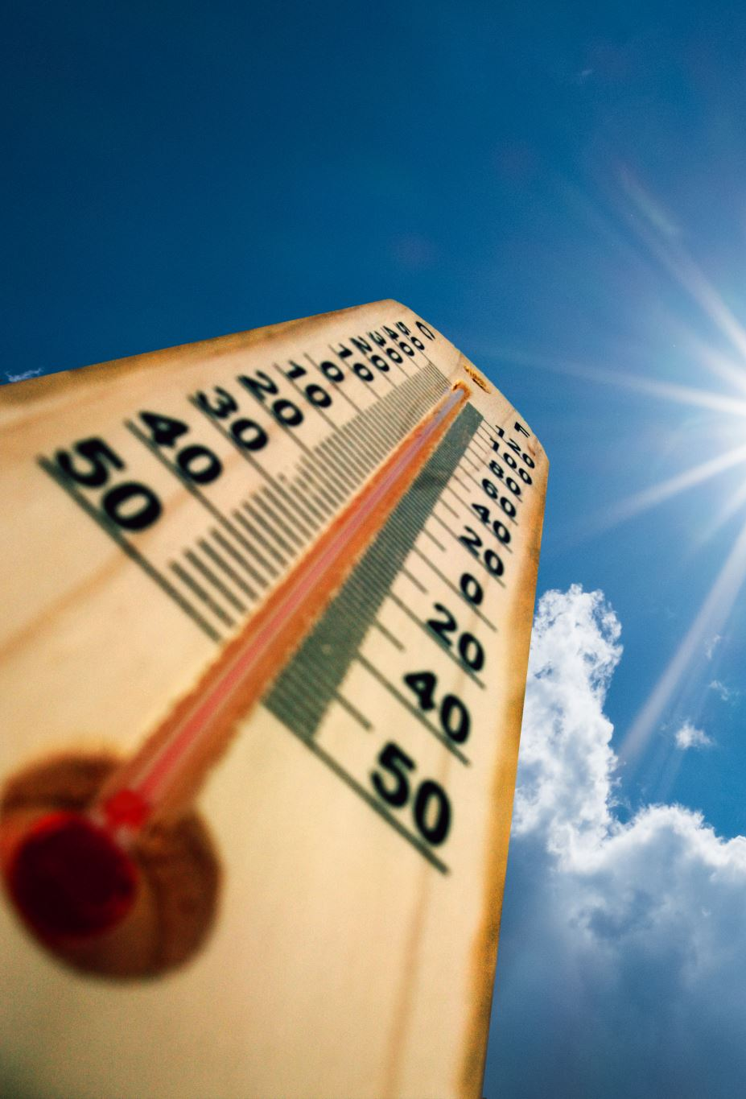
Let's look at the data produced by my own weather station …

Slide 7
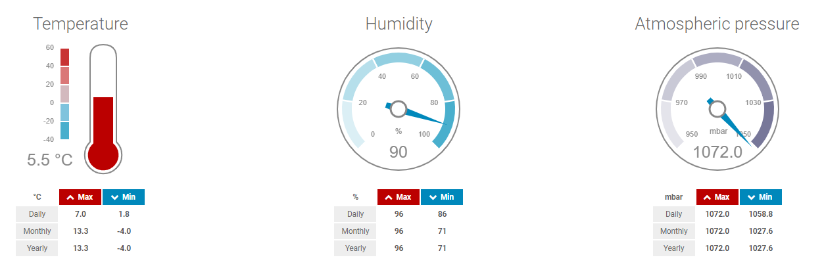
Temperature
Temperature.
This is temperature, measured in degrees celsius, and is a 'live' or 'current reading. Below, a table tells you the maximum and minimum figures for the day, month and year. This reading was taken at about 10.00 pm on the 11th January 2022. It's a very mild night for a night in early January.

Slide 8
Humidity
Humidity.
Humidity is the amount of moisture in the air. The 'wetter' the air, the heavier a dew is likely to be in the morning, and, if the temperature drops below freezing, the thicker the frost is likely to be in the morning. When you hear people saying is is 'muggy' they are referring to how 'thick' and warm the air is, and this is related to the amount of moisture in the air.
Why does it thunder when it's 'muggy' ?
This is to do with the fact that the charged droplets high up in the atmosphere can discharge more easily through moist air than they can if the air is dry. Water is a very good conductor … moist air has a high water content and so the charge stored in the clouds can discharge to ground (the planet !)

Slide 9
Atmospheric Pressure
Atmospheric Pressure
This can be a hard one for people to understand, but it is basically the 'weight' of the air pushing down on them, but also (and this is the tricky bit), the 'weight' of the air pushing up at them from below, and towards them from the sides.
We'll go into this in more detail in a future session !

Slide 10
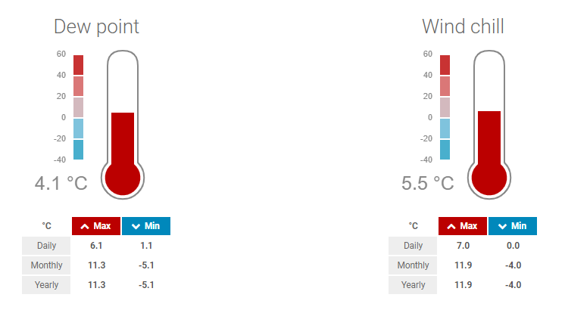
Dew Point
The Dew Point.
Remember humidity – the 'moisture content' of the air?
The Dew Point is the air temperature at which the moisture content reaches 100%, and cannot, therefore 'hold' any more water. At this temperature, or lower, any moisture coming into contact with a surface will condense into water. This is why the grass is wet in the morning even though is hasn't rained. The air has cooled to a point where it can 'hold' no more water vapour, and it releases it as water.

Slide 11
Wind Chill
So obvious it doesn’t need any explanation !!!
It can be somewhat chilly, but, if it's chilly with a cold wind, then it feels even colder … this is 'wind chill'.

Slide 12
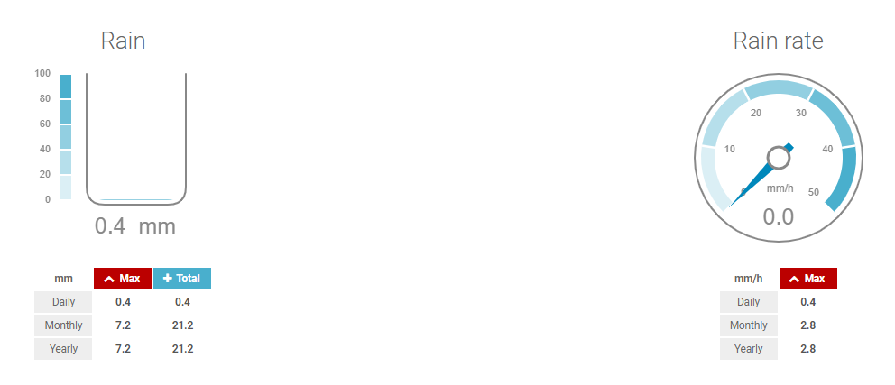
Rain
Another obvious one …
Depending on what 'scale' you have your weather station set to, this shows the amount of rain that has fallen in the last hour, or day, or week, or month. In this case, mine is set to show the rain that has fallen since midnight, and resets again on the following midnight, so it shows the rain for the current day.

Slide 13
Rain Rate (mm/h)
Rain rate.
In this case, it shows the amount of rain falling over the last hour.

Slide 14
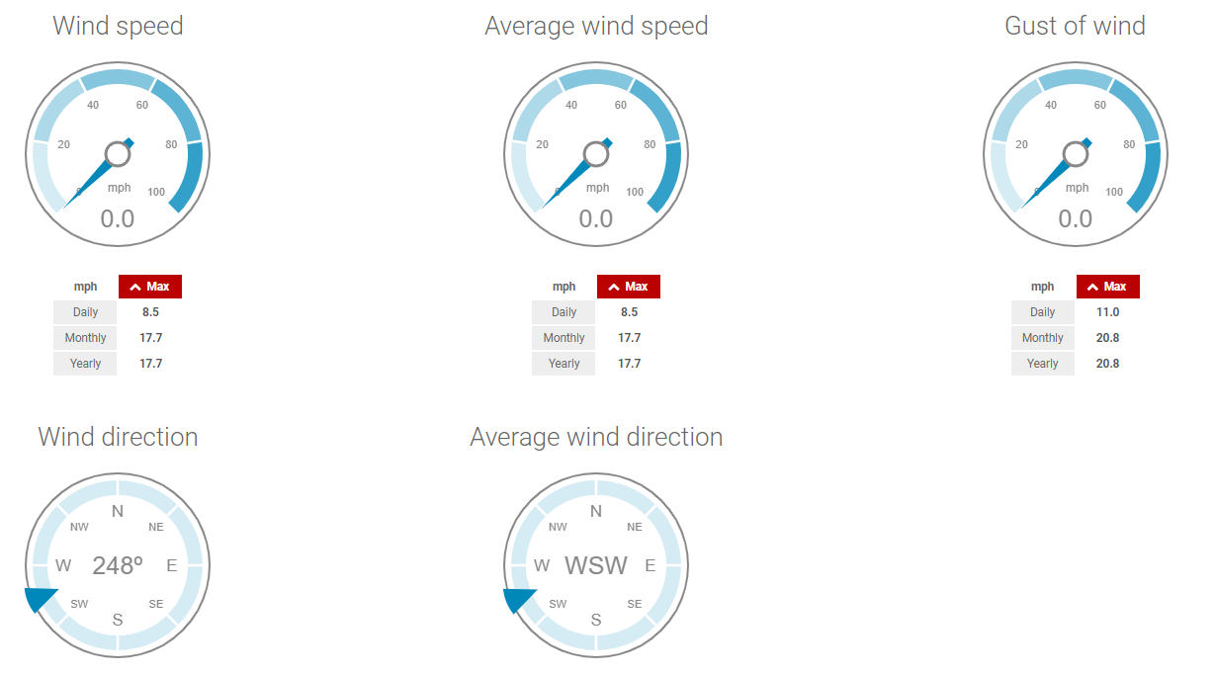
And, of course … the wind !

Slide 15
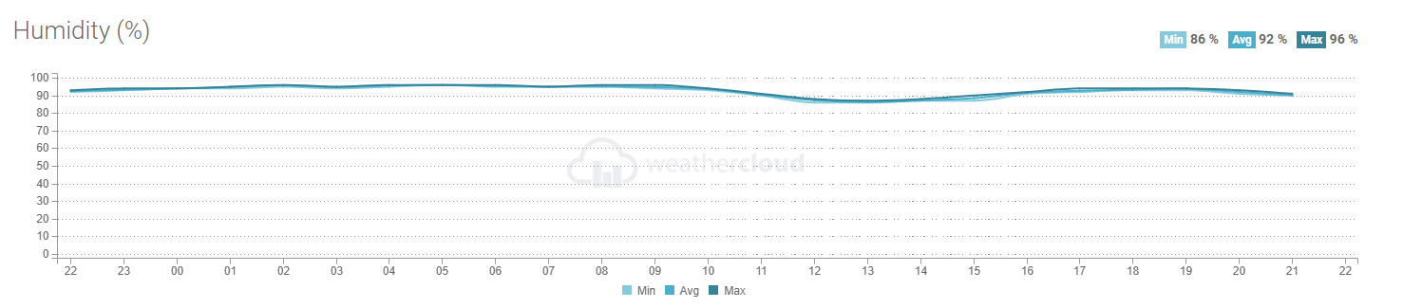
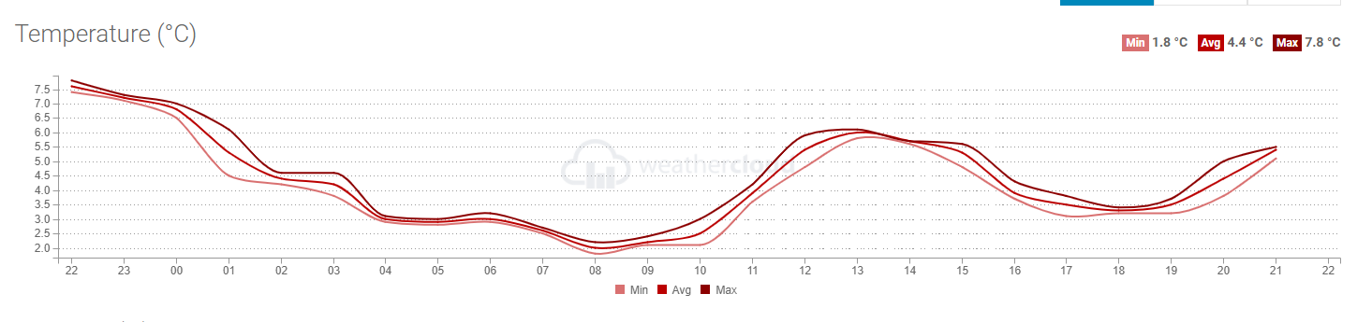
Evolution … previous 24 hours.

Slide 16
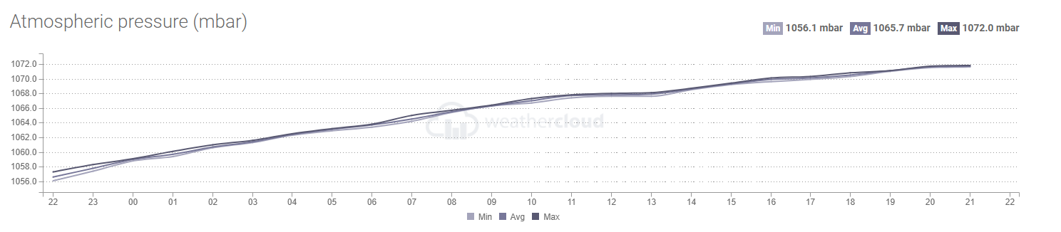
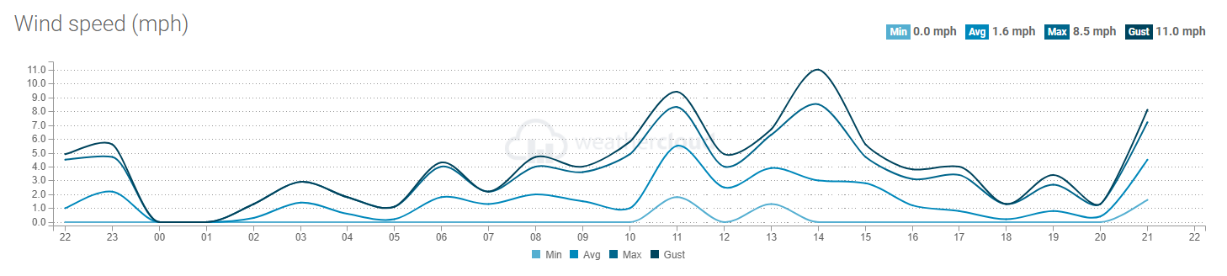
Evolution … previous 24 hours.

Slide 17
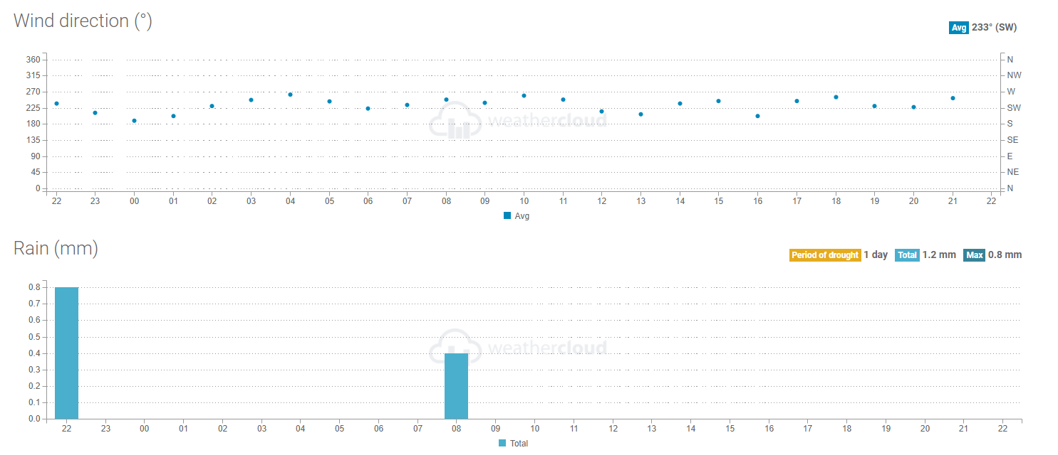
Evolution … previous 24 hours.

Slide 18
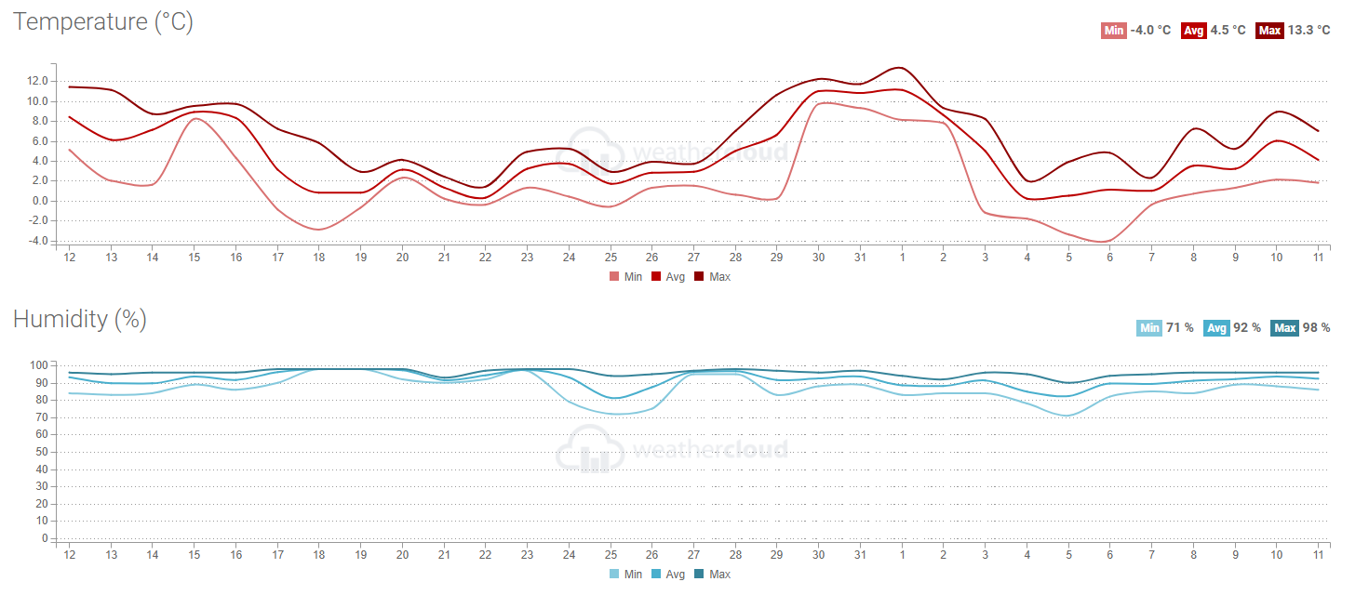
Evolution – Previous Month

Slide 19
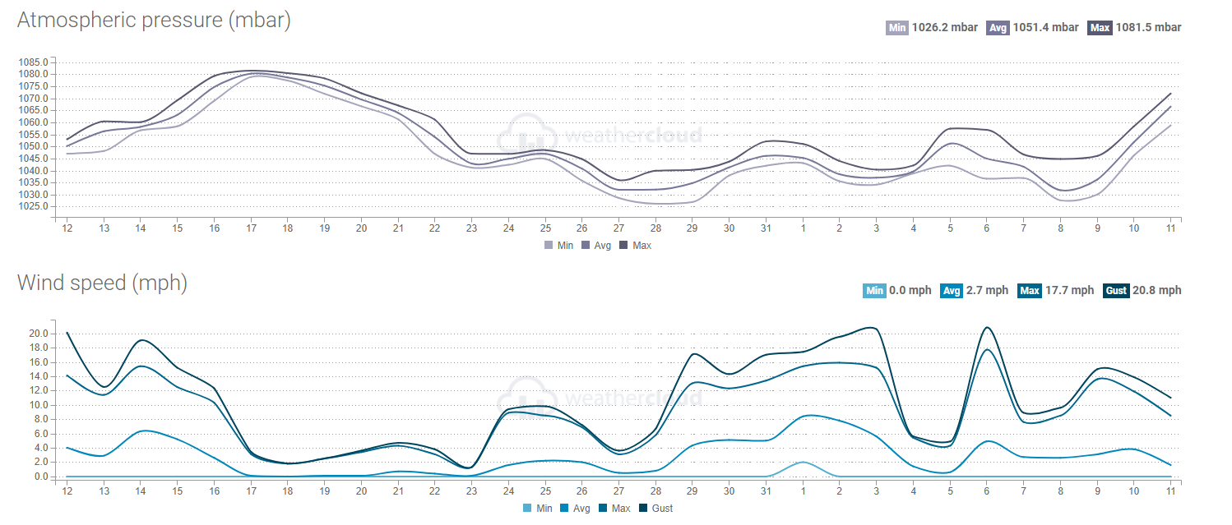
Evolution – Previous Month

Slide 20
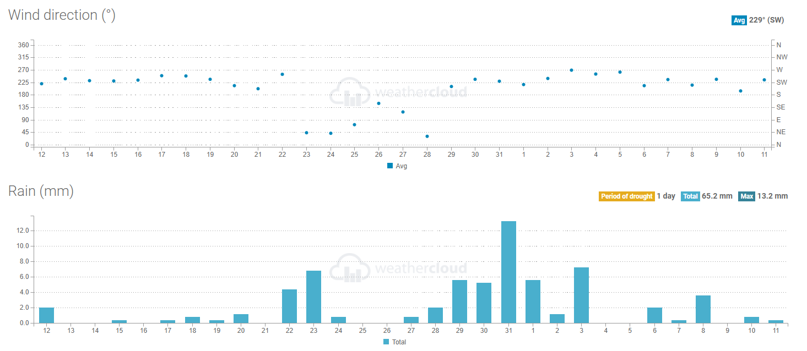
Evolution – Previous Month

Slide 21
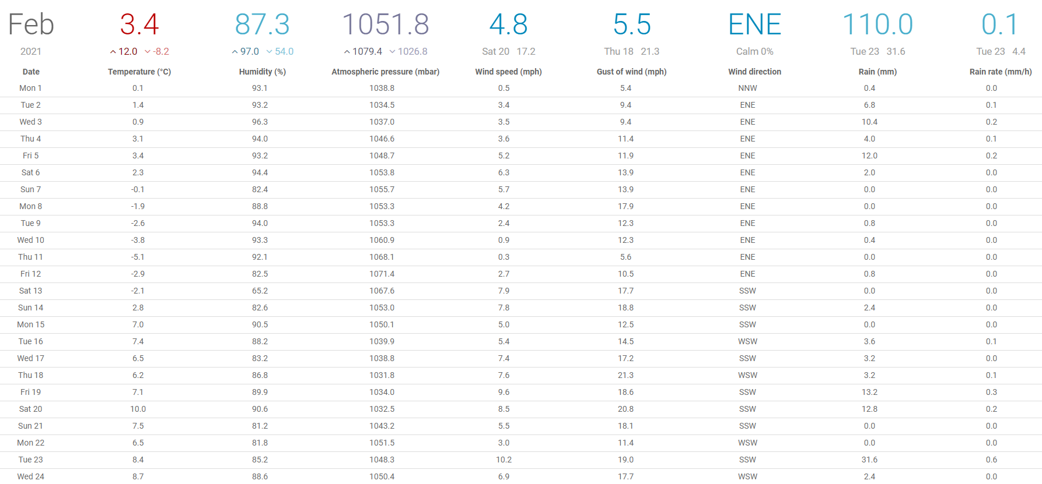
But there's more! Actual Data! Feb 2021

Slide 22
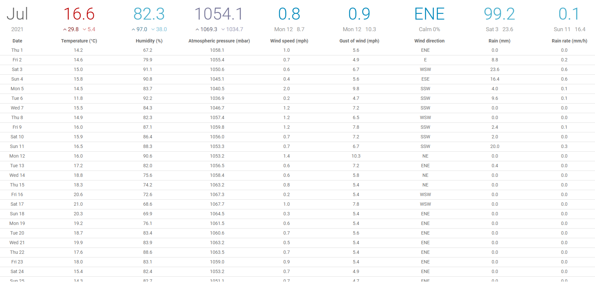
But there's more ! Actual Data !!! July 2021

Slide 23
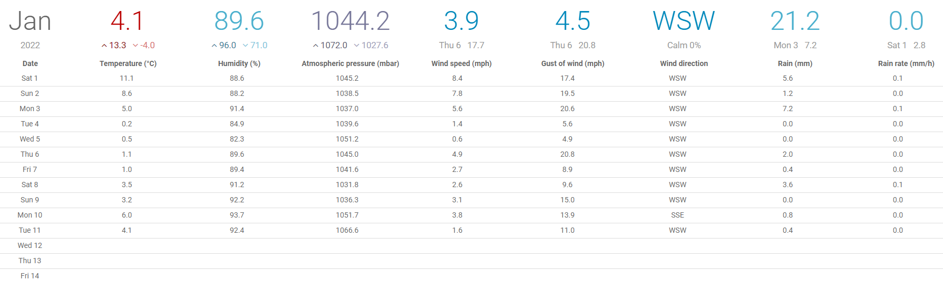
But there's more ! Actual Data !!! Jan 2022

Slide 24
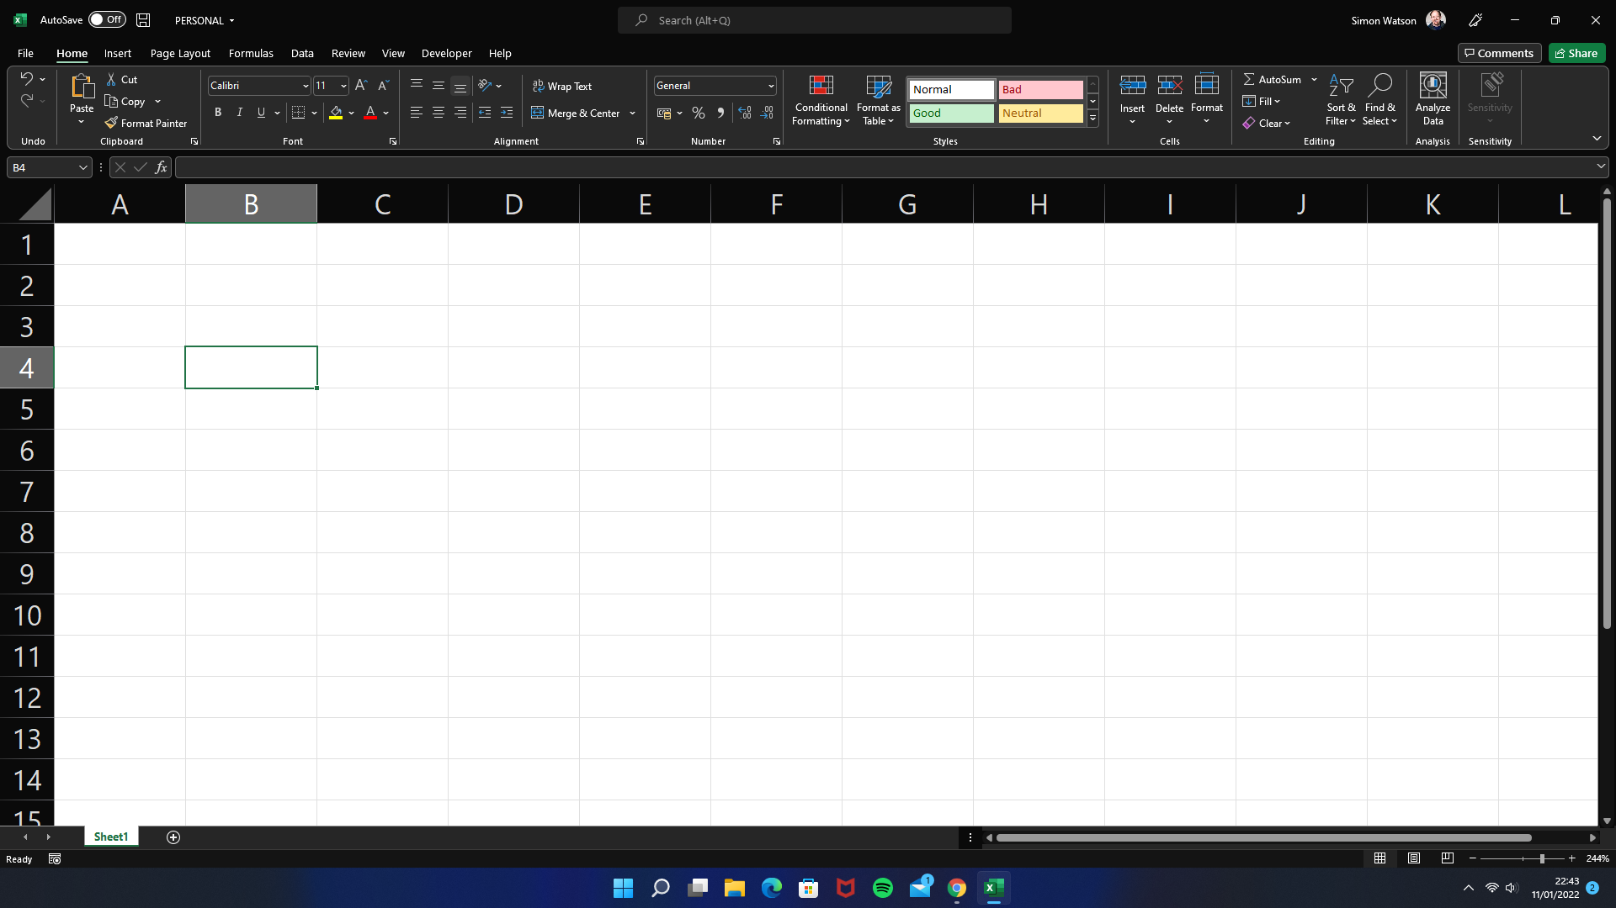
And this data can be imported …
... into a Spreadsheet !

Slide 25
Number Crunching and Data Transformation !
Using a Spreadsheet package like Excel, we can start to analyse and make sense of the data the weather station has provided for us.

Slide 26
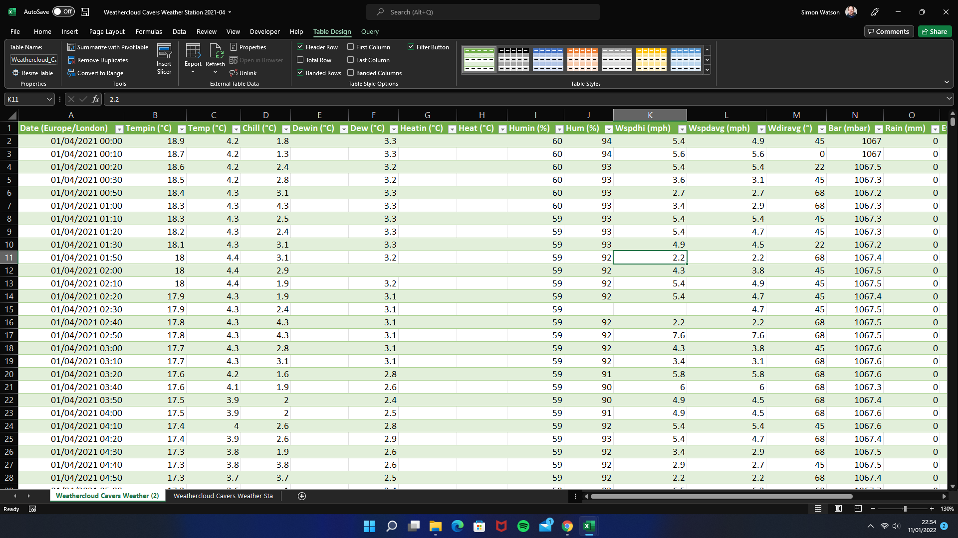

Slide 27
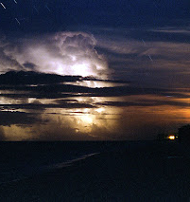
Why is this relevant to us ?
The way the data is presented to us on the website (in this case, Weathercloud.net) is absolutely fine, but by downloading the data use to generate those graphical representations, we can conduct our own much more in depth studies of specific weather events.
What about Storm Arwin? Maybe you're interested in seeing what the wind speeds were during that storm?
Or what about when Hawick was placed under a flood risk a few months ago … how much rain did it take to make the rivers swell to those dangerous levels?
All of these questions could be answered by looking at, and, if necessary, conducting some analysis on the data, looking for patterns to try to work out what 'drives' the weather we experience.
This Photo by Unknown author is licensed under CC BY-SA.

Slide 28
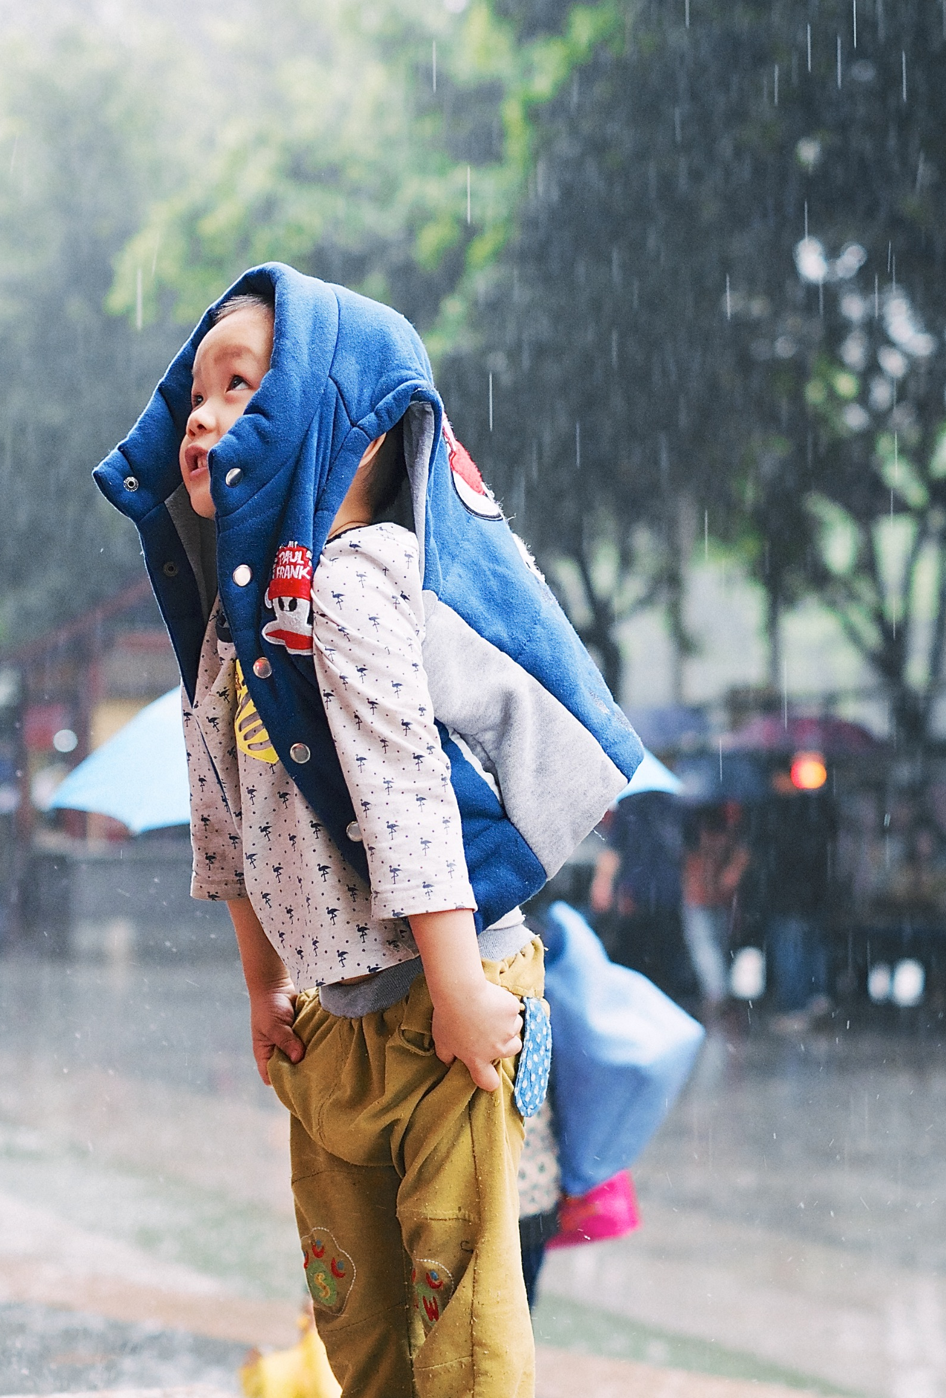
Understanding Weather
In a future session we will look, in some depth, at some of the factors which produce the weather we experience here in the UK.
It's an interesting topic, not only because the weather IS a national obsession, but also because, when we are out and about with children, if we are equipped with the knowledge to understand the weather and to be able to explain weather phenomenon to them, then we are equipping them with an understanding of the world in which they live !

Slide 29
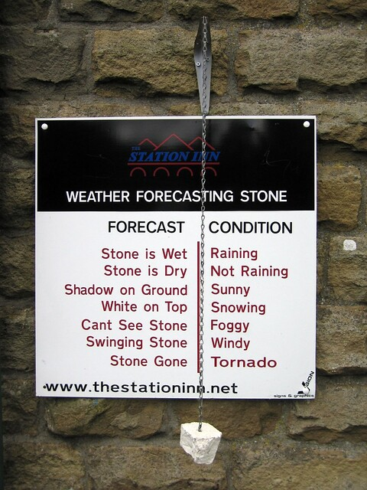
So what's this all been about, then ?
Weather, and the study of weather is a science, and the weather affects everything we do !
We can make studying weather really simple with activities for younger children like reading simple scales and numbers, but, because of the wealth of data that modern weather stations give us, we can take the study of weather to much higher levels, even to the point of analysing and interpreting complex data.
These are skills that children will need as they move towards entering the workforce. Employers, more and more, are demanding that employees have skills in what is called 'data science' and building activities around the study of the weather provides a 'real life' opportunity to develop these skills.
This Photo by Unknown author is licensed under CC BY-SA-NC.

Slide 30
Thanks for listening !

